Slide 1
Co-op 101 – Week 9
Professional Communication
& Cover Letter Tips
Brittany Root, M.Ed, PHR
Assistant Teaching Professor
Steinbright Career Development Center
Pronouns: she/her/hers
bhr26@drexel.edu

Slide 2
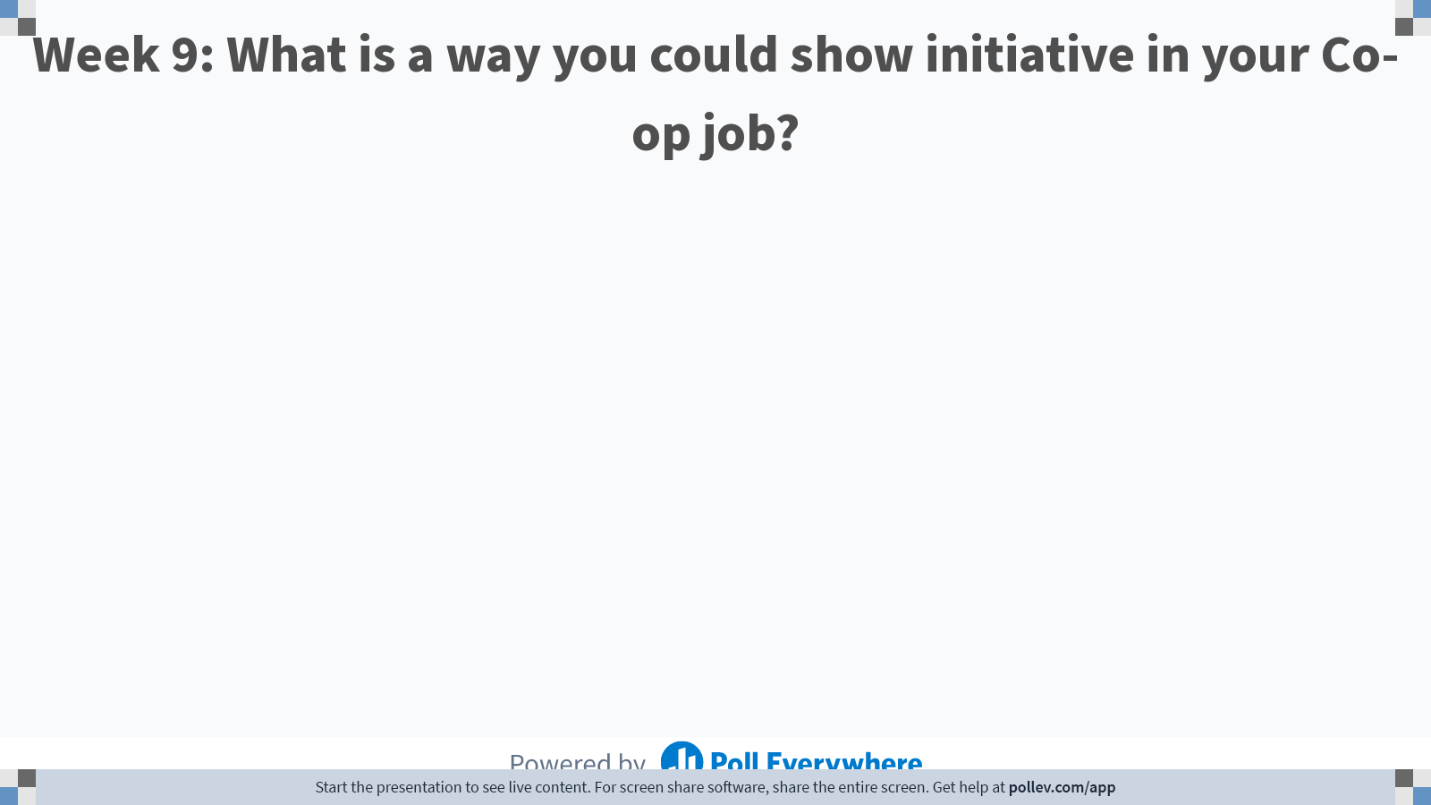
Notes:
Poll Title: Do not modify the notes in this section to avoid tampering with the Poll Everywhere activity. More info at polleverywhere.com/support Week 9: What is a way you could show initiative in your Co-op job? https://www.polleverywhere.com/free_text_polls/TBoprFszweFkaq3NGcky8

Slide 3
Today’s Agenda:
Interview Question
Workplace Tip
Effective Communication
Basics of a Cover Letter
Resume Returned

Slide 4
Workplace Tip: Show Initiative
Become an expert on your employer, What is everyone working on?
Act like an employee with a promotion at stake
Ask for feedback
Secure a mentor
Volunteer
Ask to sit-in on meetings
Notes:
Look for opportunities to learn about what those around you are working on
Don’t have the mindset that you are “ just a co-op” with a fixed end date to your employment, strive for a mindset that you are an integrated part of the team from day one working with a onger term focus within the organization.
We have discussed ways to ask for feedback in week 5’s class; remember being proactive and explicit about seeking feedback is a key strategy for success
Start thinking about a type of mentorship relationship that would be helpful in your career. This article has helpful information: https://www.themuse.com/advice/how-to-find-a-mentor
Take initiative and volunteer for extra work! Be someone who strategically asks if you can help with projects and tasks. Of course, while being mindful of how much you can take on to ensure you have the time to complete tasks well
Don’t be afraid to ask to be a “fly on the wall” in meetings. You can offer to take notes for the team and can send the notes out after the meeting or you can just be there to observe

Slide 5
Interview Question:
Tell me about a time you did not have enough information to do your job.
Important to highlight what you did to get the information!
Situation
Task
Action
Result
Notes:
Stay positive, don’t blame anyone for the lack of information. It is not uncommon on co-op to be asked to work on something without having the amount of information or training you might whish you had going into working on the project. Keep your focus on an example where you can show action steps you took to get the information you need and ultimately when you were able to get the job done well.

Slide 6
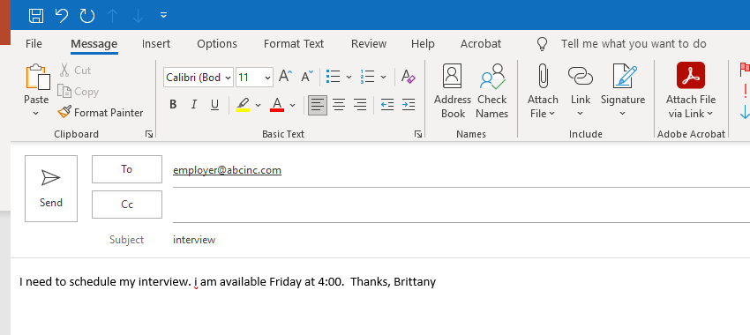
What’s wrong with this email?
Notes:
Subject Line lacking in specifics and capitalization error
No Greeting and Closing
Reads like a demand not a request and does not express gratitude for invitation to interview
Lacks the openness in availability that should be communicated, give multiple blocks of time on multiple days that you are available

Slide 7
Scheduling Interviews by Phone
Hello _______. My name is __________ and I am a Drexel University co-op student. I received notice that I have been selected for an interview for the __________________ position with your company and I am calling to arrange a time to meet with you.
Book time and ask any questions you may have, such as: Is there anything you would like me to prepare for the interview? Where will the interview be held? May I ask how many people will be meeting with me?
Listen carefully and take notes. Confirm the time by repeating it back to them.
I look forward to meeting with you on Tuesday at 10 AM. Thank you for your time. Have a nice day.
Notes:
If you are nervous speaking on the phone to an employer, it is always helpful to have a phone script ready in advance. Have your calendar ready, and a pen and paper for any notes.
Carefully read the interview instructions before you call. Ensure you know exactly who you are asking for and what the job entails. Research the company briefly online. Have an idea of where they are located and how you are going to get to the interview.
Keep in mind that many employers or recruiters may be managing multiple job openings, so you want to be precise about the job title you're inquiring about. Also, have your resume handy. You may be asked a couple of basic questions, so be prepared to speak briefly about your experience.

Slide 8
Scheduling Interviews: Leaving a Voicemail
If the employer is not available, leave a concise message and state your name and telephone number slowly and clearly.
Sample Voicemail
Hello _Employer full name___. My name is __________ and I am a Drexel University co-op student. I received notice that I have been selected for an interview for the __________________ position with your company and I was calling to arrange a time to meet with you. Thank you for the opportunity to interview for this opportunity. I can be reached at (phone number) or by email at abc12@drexel.edu. I look forward to your call. Thank you again.

Slide 9
Subject: Drexel University Co-op Interview – ________________ Position
Dear ____________,
I am a Drexel University co-op student and I received notice that I have been selected for an interview for the _____________ position with (company name). I am excited by this opportunity and look forward to learning more about your company.
I am writing today to arrange a time and location for the interview.
I am available anytime on Mondays and Fridays as well as Tuesday and Thursday afternoons after 1:00 PM. I would be happy to meet at your convenience.
I can be reached at this email address, or by phone at _____________. Thank you for your time.
Sincerely,
Your Name
***Alternatively, you could provide a link to an online calendar, such as Google, Outlook or Doodle, which allows the employer to view all your available times and select one right away.
Scheduling Interviews by Email
Notes:
Read any provided instructions carefully. Many employers ask for specific details in the subject line of the email or in the email itself, so be certain to include those. If there are no instructions, put the job title in the subject line. If you are a co-op student, it can also be helpful to include "Drexel University Co-op Interview" in the subject line.

Slide 10
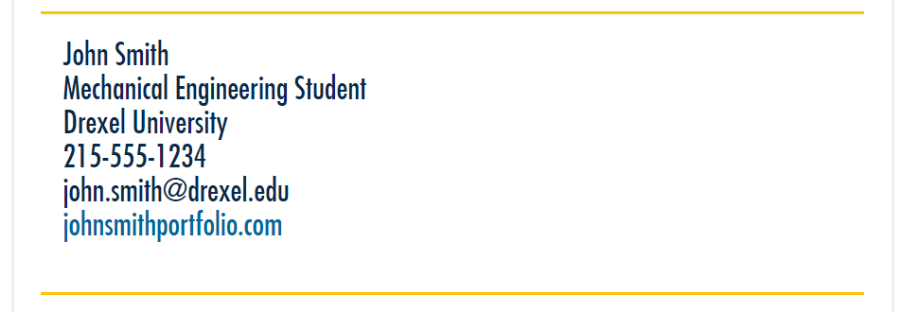
Email Signature
Notes:
Email signatures are a way to easily provide all of your contact information to the employer and to give your email the look of a workplace email communication.
You can use this sample!

Slide 11
Thank You Email
Must Be Sent within 24 Hours!
Salutation/Greeting – Address the interviewer by their full name. Avoid pronouns if unsure of correct pronoun.
Paragraph 1 – Thank them for their time and reiterate your interest in the position.
Paragraph 2 – A chance to address any unresolved issues. This may not apply to all interviews, so this is optional.
Is there a question that you wish you had answered better?
Did the employer request more information on anything?
Paragraph 3 – Reiterate your skills as they match the employer needs.
Paragraph 4 – Thank the employer again and invite the employer to let you know if there is any other information you can provide.
Closing/Sign-off – It is best to use a formal closing such as Sincerely, first and last name.
Notes:
Thank you remails are considered a requirement by most recruiters, so you should develop a well crafted and detailed thank you communication to send within 24 hours of completing the interview.
Be sure to get contact information for your interviewers before you leave the interview or sign off of a video platform.

Slide 12
Case Study: Communication on co-op
Jill started her co-op a few weeks ago. After a couple of weeks of training, she is now getting increasingly difficult projects to work on. She often needs additional information to complete the projects, but her supervisor and co-workers are busy with their own work. She isn’t sure how to get the information she needs, and doesn’t receive a response to her first email attempts to ask questions. What should she do?

Slide 13
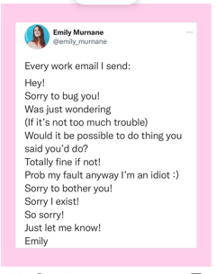
Notes:
This follow-up email is a funny email illustrating how it feels to send a follow-up, but it does a good job illustrating that you should be mindful of having a less direct/demanding email follow-up.
You should not point out directly that the person didn’t respond to a previous request. You can forward your previous email and refer to it, but you want to acknowledge that the person you are emailing is likely busy, and you should consider restating a reason for needing their assistance and you can ask what timeline might work best for them to follow up about the necessary information/deliverable.

Slide 14
Read the sample cover letter
Pair up in groups of 3 or 4
3. Discuss cover letter’s strengths and areas for improvement
4. Identify 1 group member to share out a strength and area of improvement
You be the Hiring Manager!

Slide 15
Cover Letter Basics
THE PURPOSE:
Your Chance to explain in narrative form how your skills, experience and interest match the job description!
BIGGEST MISTAKE STUDENTS MAKE:
Most of the cover letter is spent explaining why this position would be great for you, not what you will bring/how you will contribute to the employer!
THE OTHER BIG MISTAKE:
Using the same cover letter for multiple jobs.
Notes:
A cover letter is your personal introduction to a prospective employer. While a résumé is a document itemizing your abilities and experiences, a cover letter is your chance to really emphasize why and how you would be an excellent fit within the organization, letting your personality come through in your choice of words. A cover letter is an opportunity to be direct in your desire to work for an organization while also succinctly explaining what you can offer the company.

Slide 16
Cover Letter Outline
Your Name Your Street Address Email Address (Area Code) Phone Number
Month Day, Year First and Last Name of Receiver Position or Title Employer Organization's Name Employer Street Address City, State and Zip Code Dear First Last Name of Receiver (or M. Last Name if you know correct pronoun),
Notes:
The cover letter should follow a formal “business letter” format in most cases
You should use LinkedIn or other web resources to identify a specific person within company to address letter to.
There may not be an physical address for employers that have moved to fully remote operations, but the physical address of the employer’s location should be included otherwise

Slide 17
Cover Letter Outline Continued
Paragraph 1 - Introduction Tell the reader why you are writing, and name the position you are pursuing. You may state where you saw the position opening. If you have a networking contact at this company, you should refer to that person in the first paragraph. Remember, the first paragraph of a cover letter should spark the interest of the reader.
Paragraph 2 – Experience (Education) Detail past experience and how the skills you have developed make you a good candidate for the position. Refer to your resume, but do not summarize it. Focus on one or two skills that correspond with what the position requires. Remember that this should be structured more like a narrative - your resume is where you simply list experiences and accomplishments.
Paragraph 3 – Experience (employment, projects) Additional detail about your experience as it relates to the role. Paragraph 4 - Closing Thank the receiver for reviewing your resume and considering you for the position. Indicate that you would appreciate an opportunity to discuss the position in further detail at a later date.
Sincerely, Sign or scan your name here Type your name here
Notes:
See outline on this slide for sample paragraph content for the body of your cover letter

Slide 18
Due Tuesday 11/22- Video Resource (TedTalk) Reflection
Review the Assignment Instructions under the Week 9 Course Materials Folder (Note: this is not under Assignment tab). Submit through the Week 9 link.
Choose at least one video resource (Ted Talk) to watch
Submit a one paragraph reflection answering this question:
How will you apply what you learned in the video resource to interactions in your future work experience?

Slide 19
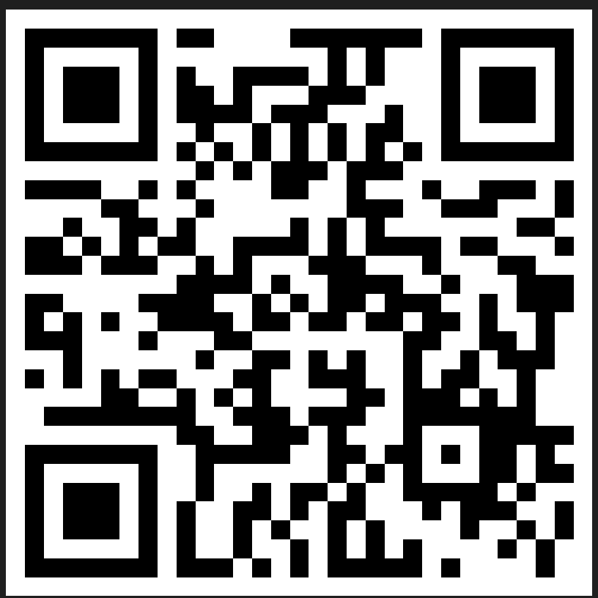

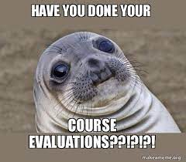
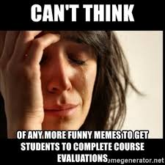
This is our Last Class! We will not have Class Week 10
Submit last assignment (Video Reflection) by November 22nd at 5:00 PM and contact me with any questions!
Course Evaluation

